Slide 1
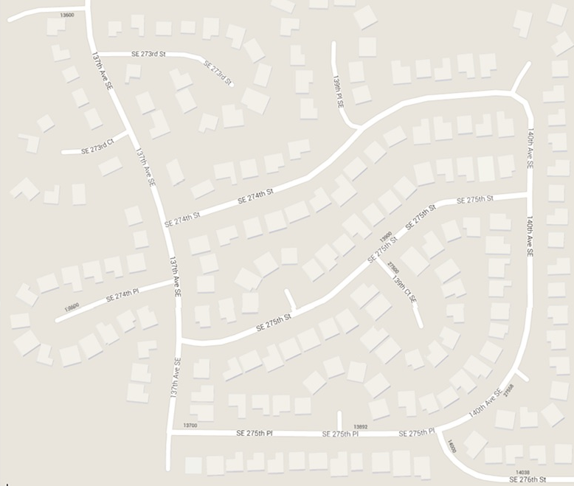



2-53
27321
2-51
27320
2-50
27324
2-57
13918
2-56
13924
2-55
13930
2-54
13936
2-49
27328
2-58
13912
(7)
(8)
2-48
27402
2-60
13921
2-61
13927
2-62
13933
2-63
13939
2-47
27408
2-59
13915
2-46
27414
2-68
13922
2-67
13926
2-66
13932
2-65
13938
2-64
13942
2-45
27420
2-69
13918
2-44
27500
2-70
13912
(9)
2-71
13906
(6)
2-42
27505
2-43
27506
2-72
13900
2-40
13923
2-41
13933
2-73
13824
2-39
13913
3-30
27513
3-29
27512
2-05
13638
2-83
27410
2-77
13730
2-76
13802
2-74
13818
2-38
13903
2-07
13626
2-06
13632
2-75
13810
2-37
27508
3-31
27517
3-28
27518
2-09
13614
2-08
13620
2-82
27416
2-78
13728
2-36
27514
3-32
27523
3-27
27524
2-10
13610
(4)
2-28
27503
(5)
(1)
2-80
13712
2-79
13722
2-29
27507
2-35
27516
3-33
27527
3-26
27530
2-11
13606
2-17
13631
2-18
13637
2-81
13704
2-27
13813
(10)
2-16
13625
(2)
(3)
2-26
13807
2-30
27511
2-34
27520
3-34
27531
2-12
13605
2-15
13619
2-19
27501
2-25
13801
3-25
27534
2-13
13609
2-14
13613
2-22
13717
2-23
13723
2-24
13729
2-31
27515
2-32
27519
2-33
27523
3-35
27537
3-01
27509
2-20
27506
2-21
13711
3-44
13808
3-43
13812
3-36
27543
3-24
27540
3-51
27512
3-45
13804
3-42
13816
3-37
13846
3-23
27544
3-02
27515
3-49
13714
3-40
13830
3-38
13840
3-50
27520
3-48
13720
3-47
13726
3-46
13732
3-41
13820
3-39
13836
(11)
3-20
27556
3-21
27552
3-22
27548
(14)
(13)
3-19
14002
3-18
14008
3-15
14026
3-03
13701
3-05
13713
3-07
13725
3-09
13803
3-11
13815
3-13
13827
3-17
14014
3-16
14020
3-04
13707
3-06
13719
3-08
13731
3-10
13809
3-12
13821
3-14
13833
(12)

Slide 2
2-53
27321
2-51
27320
2-50
27324
2-57
13918
2-56
13924
2-55
13930
2-54
13936
2-49
27328
2-58
13912
(7)
(8)
2-48
27402
2-60
13921
2-61
13927
2-62
13933
2-63
13939
2-47
27408
2-59
13915
2-46
27414
2-68
13922
2-67
13926
2-66
13932
2-65
13938
2-64
13942
2-45
27420
2-69
13918
2-44
27500
2-70
13912
(9)
2-71
13906
(6)
2-42
27505
2-43
27506
2-72
13900
2-40
13923
2-41
13933
2-73
13824
2-39
13913
3-30
27513
3-29
27512
2-05
13638
2-83
27410
2-77
13730
2-76
13802
2-74
13818
2-38
13903
2-07
13626
2-06
13632
2-75
13810
2-37
27508
3-31
27517
3-28
27518
2-09
13614
2-08
13620
2-82
27416
2-78
13728
2-36
27514
3-32
27523
3-27
27524
2-10
13610
(4)
2-28
27503
(5)
(1)
2-80
13712
2-79
13722
2-29
27507
2-35
27516
3-33
27527
3-26
27530
2-11
13606
2-17
13631
2-18
13637
2-81
13704
2-27
13813
(10)
2-16
13625
(2)
(3)
2-26
13807
2-30
27511
2-34
27520
3-34
27531
2-12
13605
2-15
13619
2-19
27501
2-25
13801
3-25
27534
2-13
13609
2-14
13613
2-22
13717
2-23
13723
2-24
13729
2-31
27515
2-32
27519
2-33
27523
3-35
27537
3-01
27509
2-20
27506
2-21
13711
3-44
13808
3-43
13812
3-36
27543
3-24
27540
3-51
27512
3-45
13804
3-42
13816
3-37
13846
3-23
27544
3-02
27515
3-49
13714
3-40
13830
3-38
13840
3-50
27520
3-48
13720
3-47
13726
3-46
13732
3-41
13820
3-39
13836
(11)
3-20
27556
3-21
27552
3-22
27548
(14)
(13)
3-19
14002
3-18
14008
3-15
14026
3-03
13701
3-05
13713
3-07
13725
3-09
13803
3-11
13815
3-13
13827
3-17
14014
3-16
14020
3-04
13707
3-06
13719
3-08
13731
3-10
13809
3-12
13821
3-14
13833
(12)

